Slide 1


Decision Tree Algorithms
Wake Forest
School of Business
_______
BAN 6025

Slide 2
Common Tree Algorithms
 | CART | CHAID | C4.5 / C5.0
Splitting Criteria
p-value |  | X
Purity measures | X |  | X
Binary Splits | X
Muti-way Splits |  | X | X
Stopping Criteria
Pre-pruning | X | X
Post-pruning |  |  | X
NOTE:
The sklearn DecisionTreeClassifier uses an optimized version of CART.

Slide 3
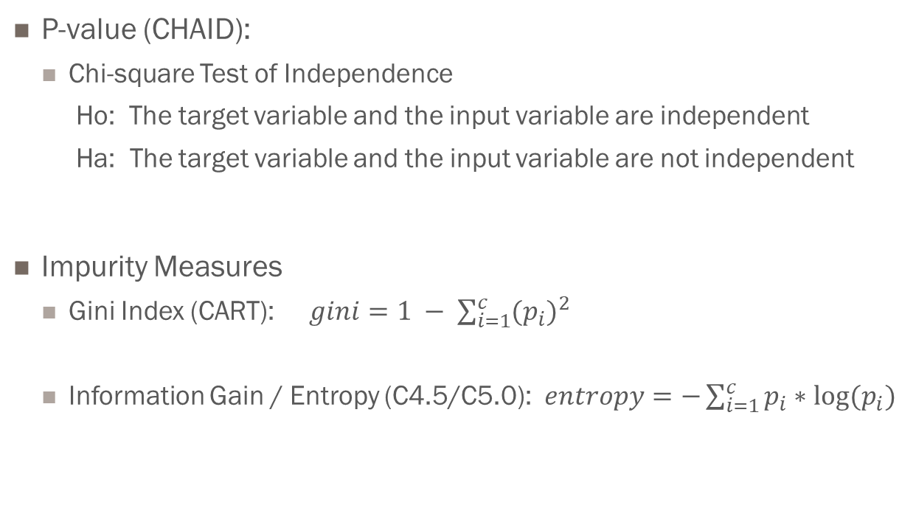
Splitting Criteria
P-value (CHAID):
Chi-square Test of Independence
Ho: The target variable and the input variable are independent
Ha: The target variable and the input variable are not independent
Impurity Measures
Gini Index (CART): $gini=1 − \sum_{i=1}^{c}{{(p_{i})}^{2}}$
Information Gain / Entropy (C4.5/C5.0): $entropy=−\sum_{i=1}^{c}{p_{i}∗log⁡(p_{i})}$

Slide 4
Binary vs Multi-Way Splits
Multi-way splits can be represented as a series of binary splits
Multi-way splits can be useful
when you have nominal variables with many levels
When you need to find the optimal way to “bin” a variable
Multi-way splits may or may not improve the accuracy of the model

Slide 5
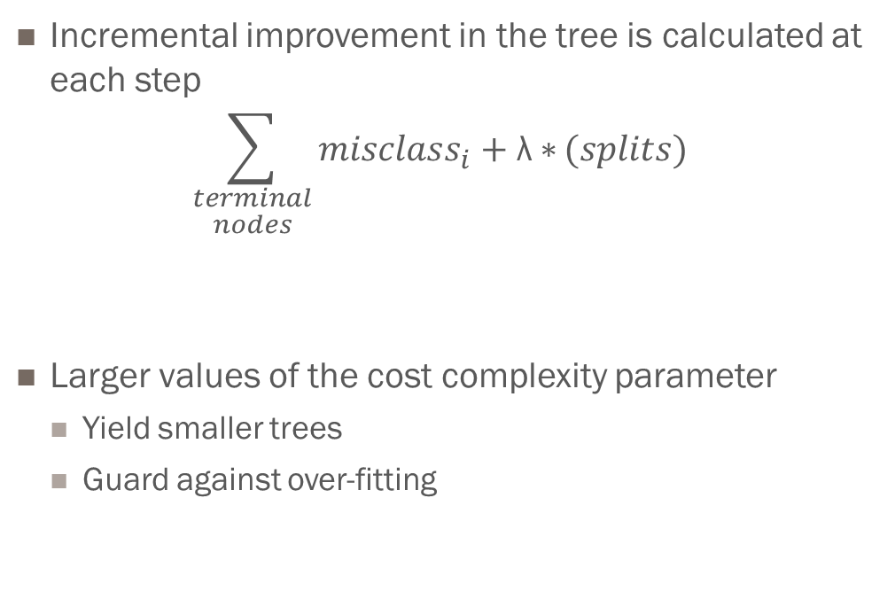
Cost Complexity Parameter
Incremental improvement in the tree is calculated at each step
$$\sum_{\begin{aligned}terminal \\ nodes\end{aligned}}{{misclass}_{i}+\text{λ}∗}(splits)$$
Larger values of the cost complexity parameter
Yield smaller trees
Guard against over-fitting

